Slide 1
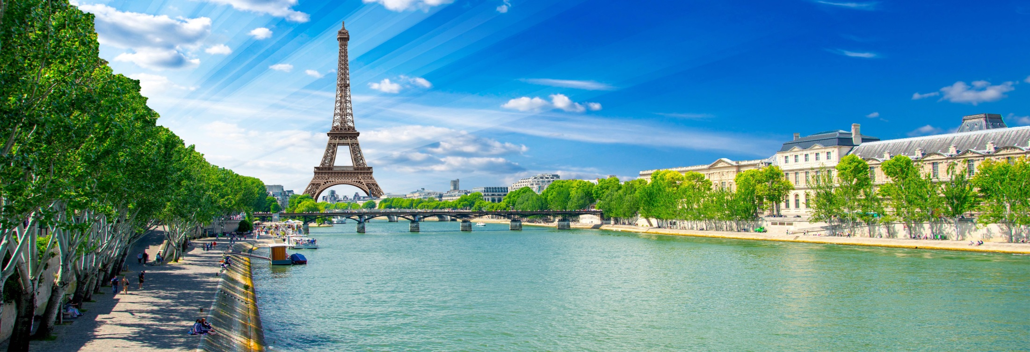
45th ASECAP Study & Information Days 2017
The Concession model in the decarbonization era: preparing the infrastructure of the future
Pullman Paris Montparnasse Hotel
29-31 May 2017
www.asecapdays.com

Slide 2
The Conccession model in the decarbonization era: preparing the infrastructure of the future
Pullman Paris Montparnasse Hotel
29-31 May 2017
www.asecapdays.com

